Slide 1
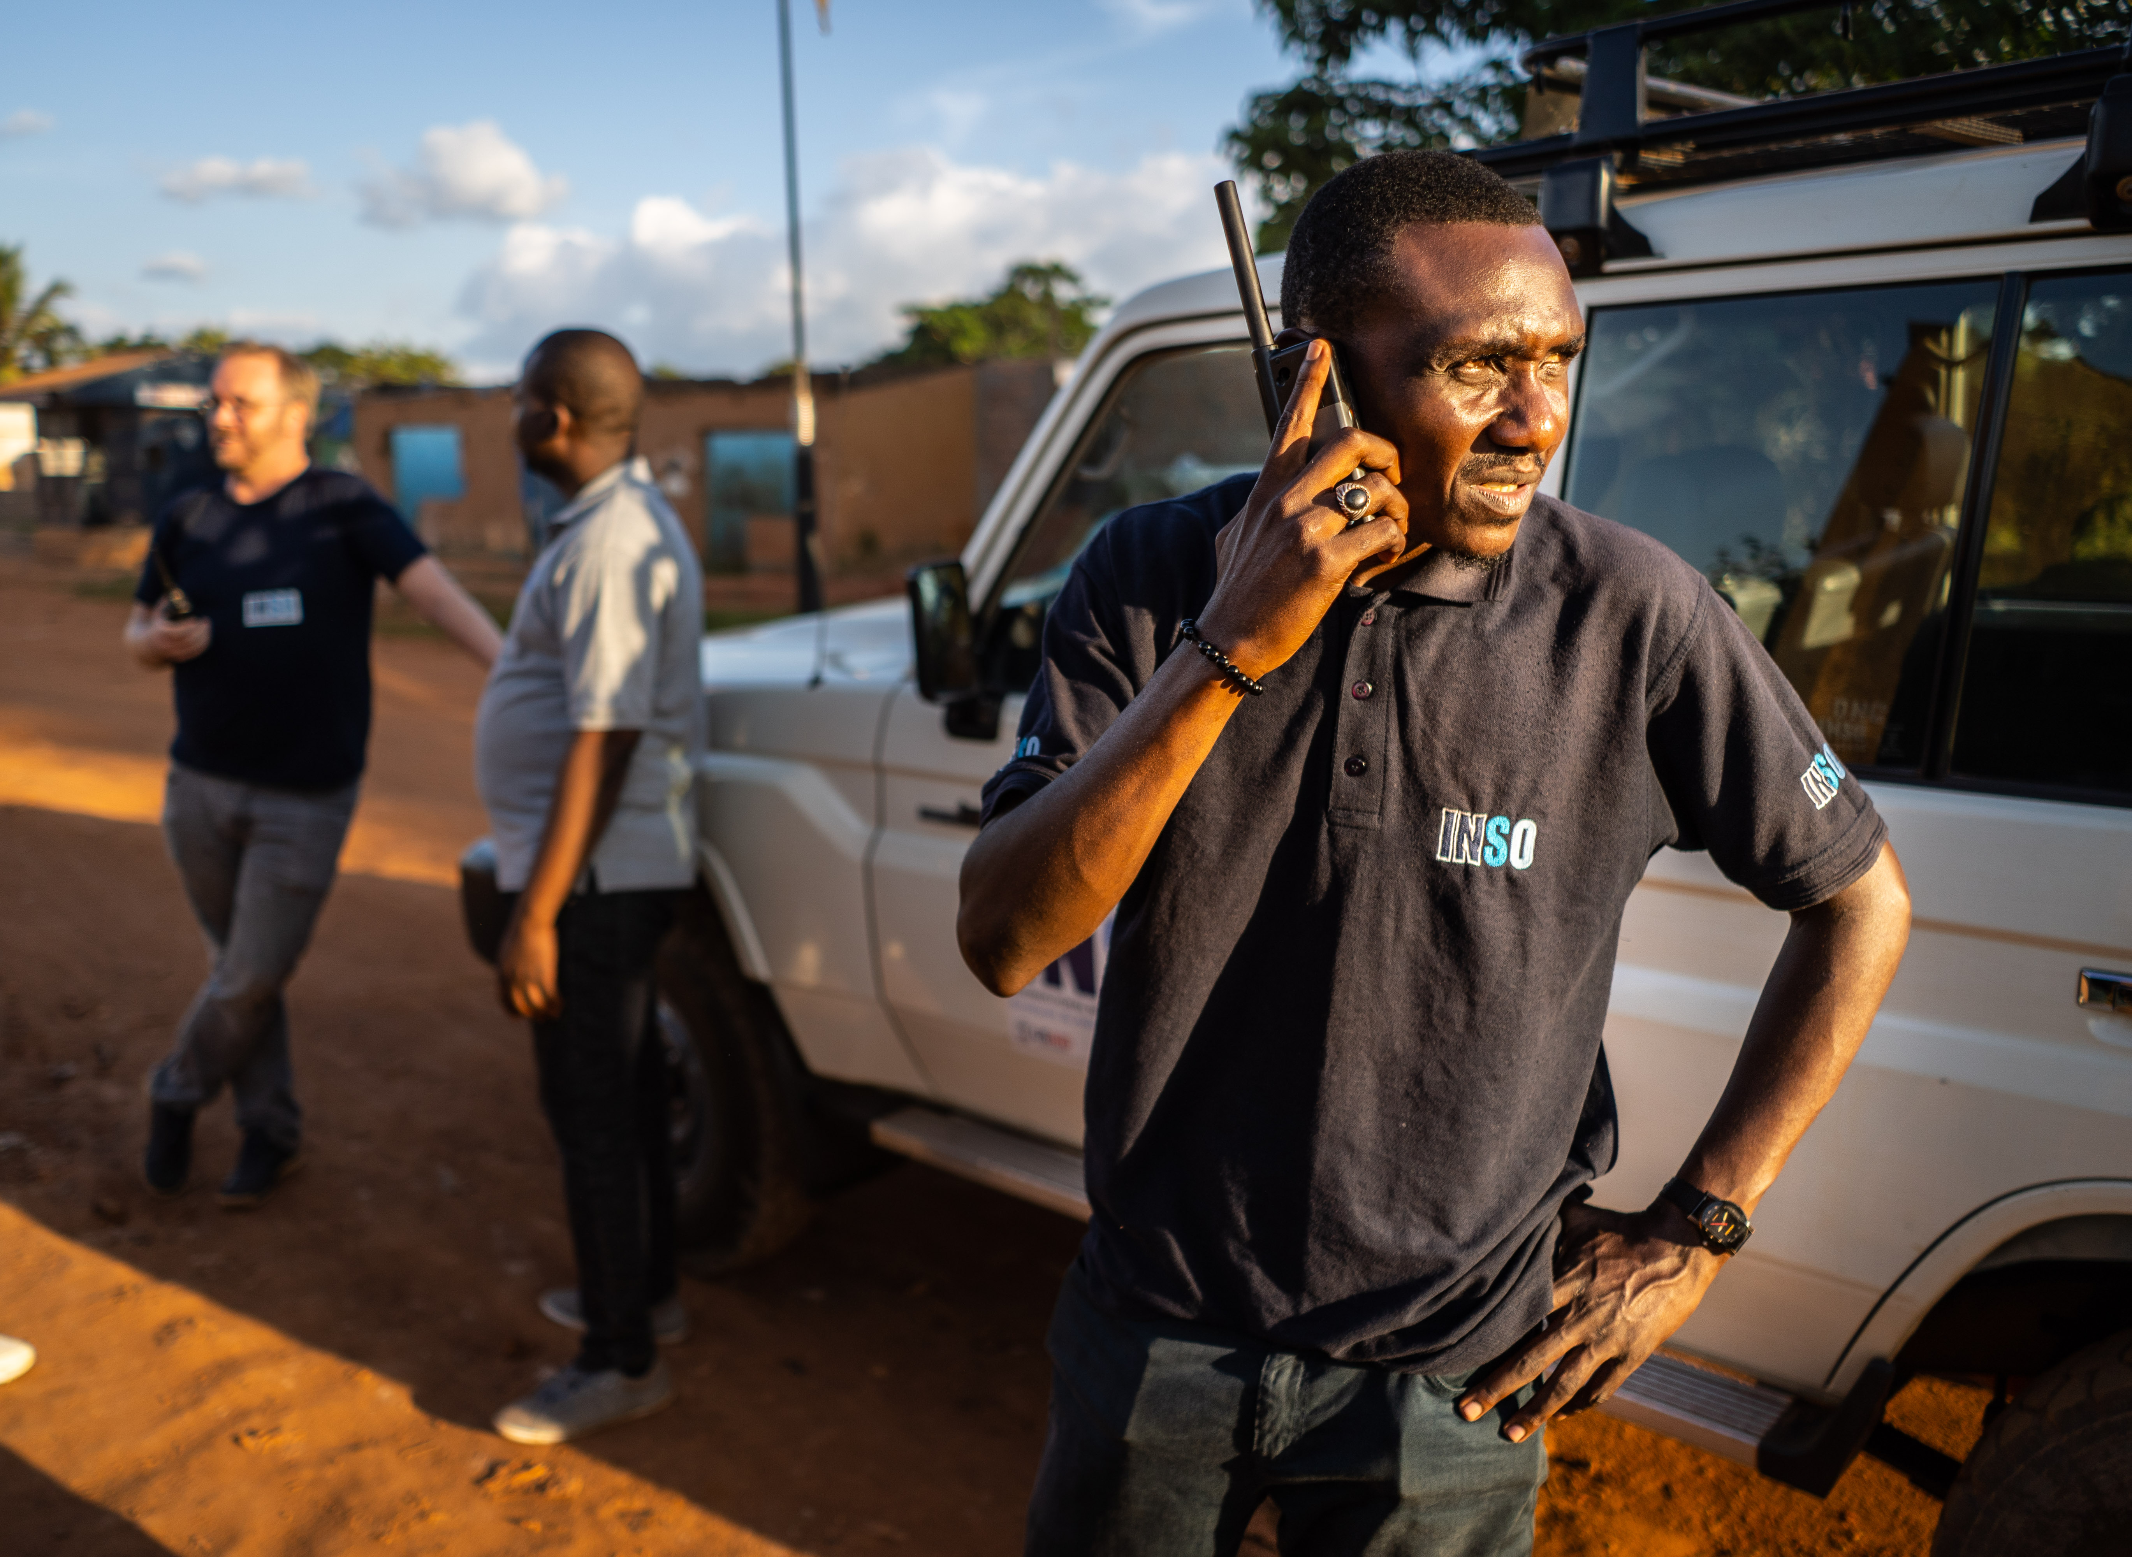
Template PPT Presentation
Advice & Analysis
For Humanitarians
xx dept/ country office
06/03/2025

Slide 2
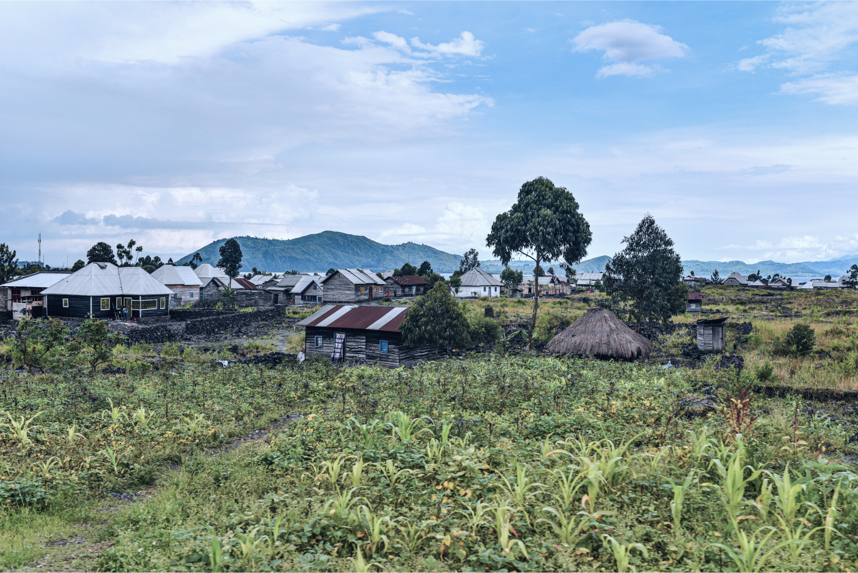
Agenda:
Aim | 2-3
Resources | 4-6
Talking Points | 7-10

Slide 3
Text + Photo Slide
What do we want to achieve?
Increased visibility around CHDC
Partners know what CHDC is and how to use it

Slide 4
3 text sections slide
Social media
Website
Offline
Over the first quarter of 2022, there was very little activity on social media (due to the personnel gap).
The launch of the new website has attracted a significant number of visitors with higher engagement.
The launch of the new website has attracted a significant number of visitors with higher engagement.

Slide 5
6 text sections slide
Social media
Website
Offline
Over the first quarter of 2022, there was very little activity on social media (due to the personnel gap).
The launch of the new website has attracted a significant number of visitors with higher engagement.
The launch of the new website has attracted a significant number of visitors with higher engagement.
Ad campaigns
SEO
Commercials
Over the first quarter of 2022, there was very little activity on social media (due to the personnel gap).
The launch of the new website has attracted a significant number of visitors with higher engagement.
The launch of the new website has attracted a significant number of visitors with higher engagement.

Slide 6
Medium 16:9 visual + text layout
Context definition
The launch of the new website has attracted a significant number of visitors with higher engagement, this can be linked to the new design and content available.
Although one-week after the launch, the number dipped slightly before stabilising to a much better level compared to the old site.​

Slide 7
Small 1:1 visual + text layout
Context definition
The launch of the new website has attracted a significant number of visitors with higher engagement, this can be linked to the new design and content available.
Although one-week after the launch, the number dipped slightly before stabilising to a much better level compared to the old site, this can be linked to the new design and content available. This has attracted a significant number of visitors with higher engagement.

Slide 8
Small visual + text layout
Context definition
The launch of the new website has attracted a significant number of visitors with higher engagement, this can be linked to the new design and content available.
Although one-week after the launch, the number dipped slightly before stabilising to a much better level compared to the old site.​

Slide 9
Big visual + list layout
Support
Media inquiries
Guidance on branding and content creation
Donor visibility – photoshoots, branded merchandise
Story telling
Engaging on social media
Communication trainings (TBC)
AOS

Slide 10
Table layout
Column title 1 | Column title 2 | Column title 3 | Column title 4 | Column title 5
Column value | Column value | Column value | Column value | Column value
Column value | Column value | Column value | Column value | Column value
Column value | Column value | Column value | Column value | Column value
Column value | Column value | Column value | Column value | Column value

Slide 11
Separate tables 1
New social followers
New social followers
534
Facebook Previous Q: 604
534
Facebook Previous Q: 604
2,564
LinkedIn Previous Q: 5,111
2,564
LinkedIn Previous Q: 5,111
Website av. time on site
104
Twitter Previous Q: 153
104
Twitter Previous Q: 153
2:11
Old website monthly: 1:52

Slide 12
Separate tables 2
New social followers
Website monthly visits
Website monthly visits
Social impressions
534
Facebook Previous Q: 604
14,184
14,184
9.8K
Facebook (reach – single view) Previous Q: 9.6K
Old website monthly: 11,895
Old website monthly: 11,895
2,564
LinkedIn Previous Q: 5,111
117.3K
LinkedIn Previous Q: 202.2K
Website av. time on site
Website av. time on site
104
Twitter Previous Q: 153
27.3K
Twitter Previous Q: 49K
2:11
2:11
Old website monthly: 1:52
Old website monthly: 1:52

Slide 13
Figures slide
30,692
1,709
Flash alerts sent to partners
Area assessments delivered
30,692
1,709
12,644
Flash alerts sent to partners
Flash alerts sent to partners
Partner staff trained

Slide 14
Pie chart slide
Our Spending 2020
Over the first quarter of 2022, there was very little activity on social media (due to the personnel gap).

Slide 15
Bar chart slide
Our income 2020

Slide 16
Thank you
Advice & Analysis
For Humanitarians
Your full name
+xx xxxxx xxxxxxx
First.lastname@hq.ngosafety.org
More from INSO at
www.NGOsafety.org

